Slide 1

AI for Redshift Inference
Sam Knisely, Darreion Bailey

Slide 2
Agenda
1.
Introduction
2.
Methods
3.
Benchmarking
4.
Next Steps

Slide 3
Agenda
1.
Introduction
2.
Methods
3.
Benchmarking
4.
Next Steps

Slide 4
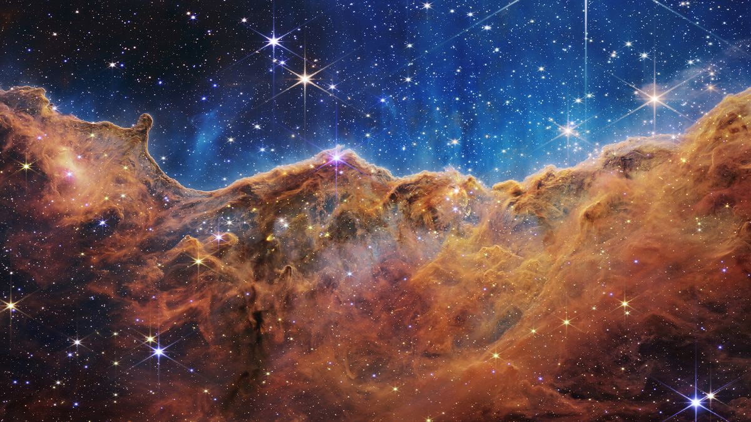
Introduction
Introduction
Detect anomalies in space images using parallel AI model inference on AWS.
Test varying partition sizes and batch sizes to see impact on training time and cost.
Data stored as a large Pytorch TensorDataset object and can be uploaded to an S3 bucket.

Slide 5
Agenda
1.
Introduction
2.
Methods
3.
Benchmarking
4.
Next Steps

Slide 6
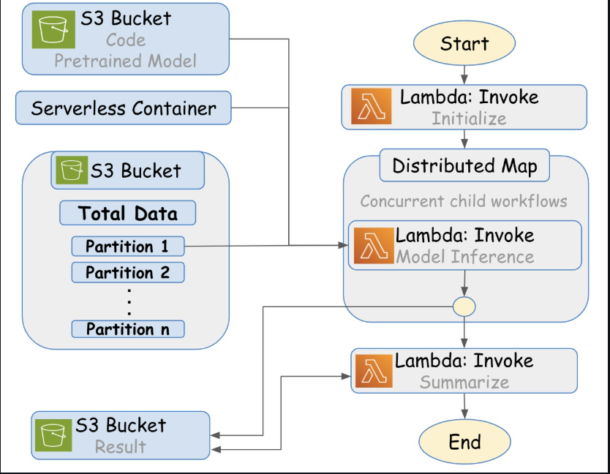
Methods
AWS Step Function
Manages interaction of FaaS Message Interface (FMI) lambda functions.
Number of lambda functions impacts time and cost.

Slide 7
Methods
Rendezvous Server
Help distributed worker nodes (e.g., GPUs) find each other and form a communication group before training starts.
Enables distributed ML training.

Slide 8
Methods
Astronomy Inference
Uses fine-tuned PyTorch neural network (~15M parameters, 25MB).
Predicts redshift values from preprocessed astronomical data.
Accepts inputs as Pytorch TensorDataset stored in S3.
Supports batching for efficient GPU or CPU usage across Lambda.

Slide 9
Methods
Cosmic AI with Lambda FMI
End-to-end AI workflow combining PyTorch inference, FMI, and AWS.
Input data chunked and dispatched to Lambdas via FMI coordination.
Each Lambda runs a portion of the model on a data shard.
Output predictions are aggregated for final redshift estimation.

Slide 10
Agenda
1.
Introduction
2.
Methods
3.
Benchmarking
4.
Next Steps

Slide 11
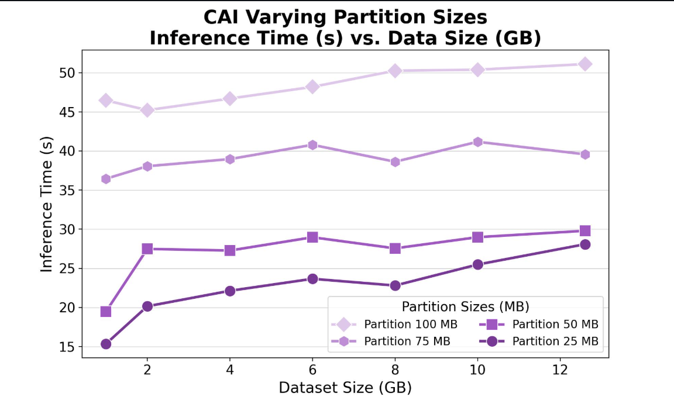
Benchmarking
Benchmarking
Measure cost and inference time on varying data partitions, sizes, and batch sizes.
Longer inference time increases compute costs but costs could also scale non-linearly due to parallel computing, autoscaling, and instance provisioning.

Slide 12
Agenda
1.
Introduction
2.
Methods
3.
Benchmarking
4.
Next Steps

Slide 13
Next Steps
Next Steps
Finalize AWS Step Function Orchestration with Lambda + FMI Integration.
Optimize PyTorch inference runtime with batching & partition tuning.
Conduct large-scale benchmarking across variable configurations.

